Slide 1


Digital Advertisement
An application of data analytics
Submitted By:
Shubham Shastri
MCA/10024/18

Slide 2
What is Digital Advertisement
Digital advertisement is the practice of delivering promotional content to users through various online and digital channels. It uses mediums such as social media, email, search engines, mobile apps, affiliate programs and websites to show advertisements and messages to audiences.
It also helps to select target audience for a specific purpose

Slide 3
How it is different from Traditional Advertisement
COMMUNICATION
VALUE VS. ADVERTISING
DATA-DRIVEN
The primary difference between digital marketing and traditional advertising is that many digital marketers look to provide value to their audience by using content marketing and other solutions. Traditional advertisers are typically just looking to increase sales with their ad spots, not to provide value.

Slide 4
Advantages of Digital Advertising
It’s Cost Effective
Stay in Control of Your Budget
Instant Gratification
Real-time Trackability
Selection of Right Target audience

Slide 5
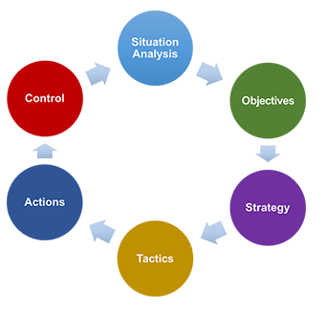
Digital Marketing Strategy
digital marketing strategy is the series of actions that you can
take to help your business achieve your marketing goals through
digital mediums and campaigns. We believe that digital marketing
strategies are essential to take the advantage of the growing
opportunities from digital marketing to overcome the competition
and earn a better position in the market.

Slide 6
Latest Digital Marketing Strategies and their implementations
Get Set with Instagram
Paid Promotion on Facebook
Youtube videos
Twitter Outreach
Blogging
Email Marketing
PPC and Google+ Plan

Slide 7
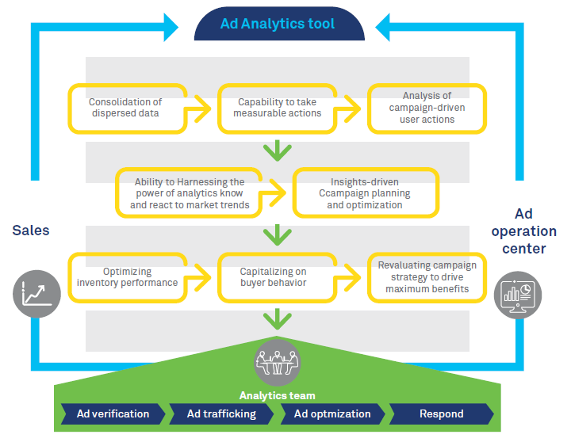
How To Implement

Slide 8
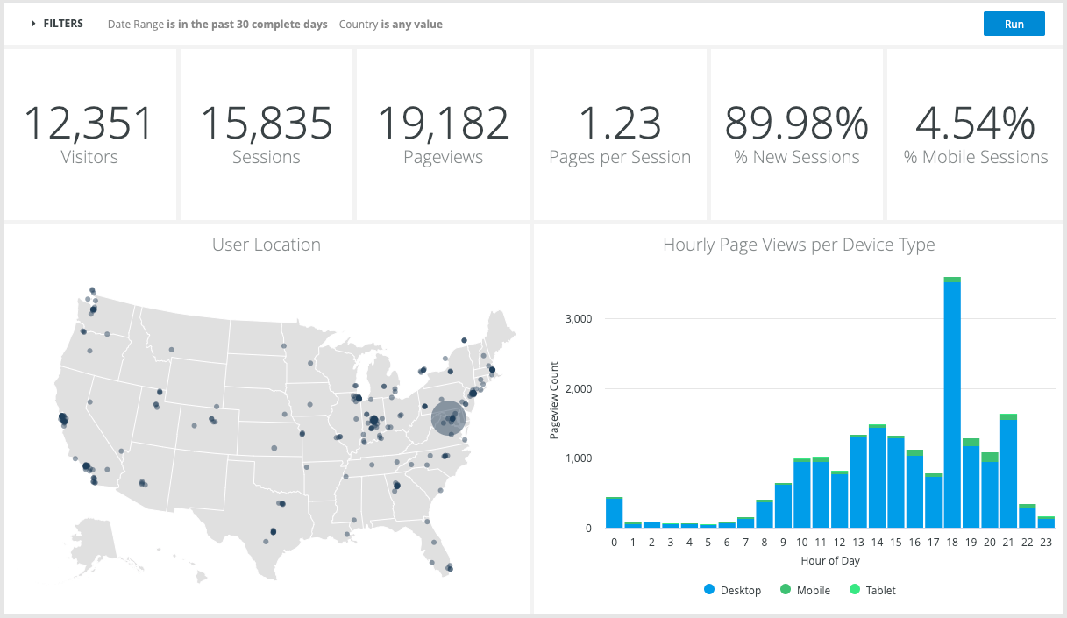
Web Analytics
Email engagement
Social media interactions
Online sales and leads
Offline sales
Website Traffic
Website Events
Digital advertising
SEO/SEM

Slide 9
Ad Analytic Tools
1.Digital marketing analytics tools
Search engine optimization (SEO) tools
Search engine marketing (SEM) tools
Predictive-scoring model platforms
1. Event-based tools
Website analytics tools such as Mixpanel
App analytics platforms such as Mixpanel
Marketing automation such as Marketo, Hubspot, Pardot, and Eloqua
Data platforms such as mParticle, and Segment
2. Testing tools
Email, In-app notifications,Push notifications,SMS,Web-hook
3. Visual behavior tools

Slide 10
Conclusion
With all of the data and analytics that are available, pulling them together into a cohesive picture that allows you to make decisions becomes a greater challenge. This is where cross-channel analytics tools become extremely valuable, allowing marketers to visualize and understand the thousands of data points and pull them together into usable data analysis for your marketing strategy. Adjusting your marketing mix by using data analytics tools for digital marketing helps marketers feel more in control, with campaign analytics tools that help enhance their data analysis and marketing strategy.

Slide 11
Thank You

